Slide 1
Comment Resolution
Jodi Haasz
Manager, Operational Program Management
9 May 2019

Slide 2
Agenda
Comment Resolution
What it is
IEEE-SA Operations Manual
Do’s and Don’ts
RevCom Comments
Questions

Slide 3
Comment Resolution
After a ballot has completed, the Working Group will need to respond to the commenters
The WG Chair can form a “Comment Resolution Group” (BRC) to resolve the comments
Document in meeting minutes what the scope of the CRG is
Resolve the comments (accepted, rejected, revised)
Can split work and assign roles to expedite process

Slide 4
IEEE-SA Operations Manual
5.4.3.3 Comments in the ballot
The Sponsor shall consider all comments that are received by the close of the ballot. Comments received after the close of balloting will be provided to the Sponsor. The Sponsor shall acknowledge the receipt of these late comments to the initiator and take such action as the Sponsor deems appropriate.
The Sponsor shall make a reasonable attempt to resolve all Do Not Approve votes that are accompanied by comments. Comments that advocate changes in the proposed standard, whether technical or editorial, may be accepted, revised, or rejected.
Sponsors shall provide evidence of the consideration of each comment via approved IEEE Standards Association balloting tools.

Slide 5
How to Access the Comments
Download the .zip file containing a CSV file of the comments and any files that may be attached to the comments.
Edit the CSV file using any spreadsheet editor and save the file in either .csv or .xls format.

Slide 6
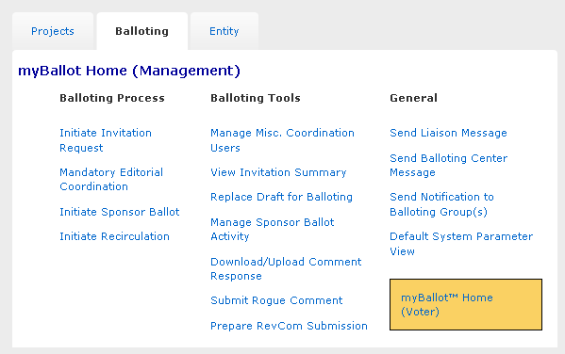
Download Comments Resolution File

Slide 7
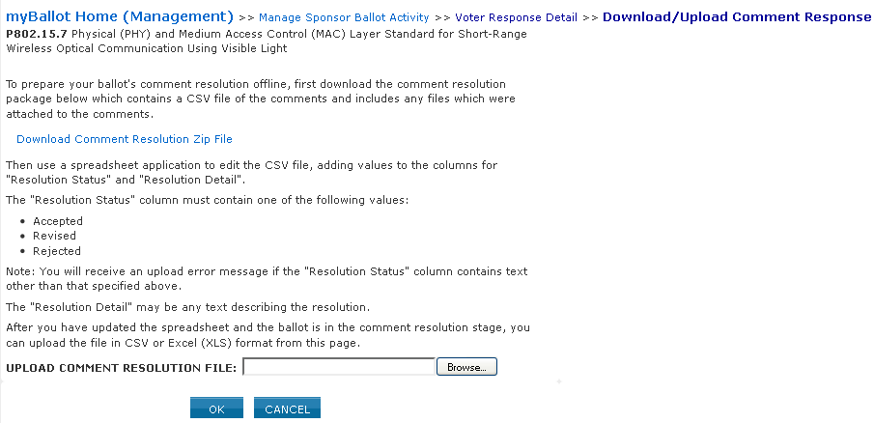
Download Comments Resolution File (Continued)

Slide 8
Resolution Statuses
Accepted – The committee agrees with the comment and implements change exactly as suggested.
Revised – The ballot resolution committee accepts the suggested remedy in principle. This means that the ballot resolution committee will make a change to the draft based on a revision of the suggested remedy. The Resolution Detail field shall provide sufficient detail for ballot group members to understand the revision of the suggested remedy provided by the commenter.
Rejected – The ballot resolution committee does not accept the suggested remedy. The Resolution Detail field shall provide sufficient detail for ballot group members to understand the rationale for this rejection.

Slide 9
Open Source
All open source code edits shall take place in the IEEE repository
All contributions need to be under the appropriate Contributor License Agreement (CLA): Apache 2.0 or BSD 3-Clause
Upon formation of the CRG, IEEE-SA will assign appropriate project access controls on the repository (e.g., the role of maintainer).
The comment resolution group can establish their workflow for comment resolution on the repository.

Slide 10
Do’s and Don’ts
Don’t make, or promise to make, any post-ballot changes to the draft. If you do RevCom would require a recirculation
RevCom will review the last balloted draft
Do reject an editorial comment and defer it to IEEE-Editorial for review (not for change)
You cannot make the promise that IEEE-Editorial will indeed make the change, just defer for review for change
Example Comment: Resize Figure 1 to fit the page better
Don’t: Accepted. Resized the figure.
Do: Rejected. Defer this change to IEEE-Editorial staff for review and change during final publication

Slide 11
Do’s and Don’ts
Don’t have any empty disposition status or detail columns
All comments need to be shown consideration
If “accepted” a comment can simply put “change made.”
Do have sufficient detail explaining the reason for rejection or the revised comment

Slide 12
Do’s and Don’ts
Don’t have an outstanding negative ballot with comment(s) and submit to RevCom without addressing the comment(s)
Do email the balloter a reason for rejecting the comment and advise he/she that you are submitting to RevCom.
Do include this email to RevCom

Slide 13
Do’s and Don’ts
Don’t cross reference
“Disagree – see resolution of comment 1234”
Do cut and paste the comment resolution from the cited comment and then add “(same comment resolution as comment 1234)”
Don’t reference an external document
“Disagree – see 11-09/9876r1”
Not an appropriate response
Do copy information from document 11-09/9876r1 and paste it in the resolution

Slide 14
Do’s and Don’ts
Don’t reference an external document
“Disagree – see 11-09/9876r1”
Not an appropriate response
Do copy information from document 11-09/9876r1 and paste it in the resolution

Slide 15
Last recirculation
If a ballot receives no comments, or receives only comments that are not new, out of scope (& notified to voter - see next slide), or not associated with a “no” vote; then no further recirculation is necessary.
Otherwise, if a ballot receives comments that are new, in scope, and associated with a “no” vote that are all rejected by the CRG, an unchanged draft is sent to the next (final) recirculation along with the reasons for these rejections
Comments might be received from this final recirculation, but they are either a reiteration of an earlier comment (i.e., not new) or they are out of scope.
Thus the process is guaranteed to terminate, should the CRG so wish
i.e., no commenter can force the process to continue indefinitely

Slide 16
Submission to RevCom
Final approval of a standard is achieved by submitting the document and supporting material to the Review Committee (RevCom), which issues a recommendation to the IEEE-SA Standards Board
Once a project is submitted to RevCom the Working Group Chair is responsible to responding to any comments/questions raised by the RevCom Members
Dialogue and Responses is done via myProject
WG Chairs will receive automatic notification email from myProject that a comment has been made
Don’t reply to the email
Do log into myProject and post a response

Slide 17
Questions???
Tom Thompson
Thomas.Thompson@ieee.org
Office Phone: +1 732 562 5564
Mobile Phone: +1 732 540 4053

